Slide 1
CHP 3 The Structure of Matter and the Chemical Elements
A branch of science that deals with the composition, structure, properties and reactions (transformations) of matter.

Slide 2
DESCRIPTION OF MATTER
(anything that has mass and occupies space)
Substances that are visible and invisible
Substances that are living and nonliving

Slide 3
Matter doesn’t include energy, in its various forms
(E.g., heat, light, electricity)
All transformations of matter involve energy changes. Chemist are interested in the energy changes that occur when matter is transformed.

Slide 4
States of Matter (p. 76)
Three states of matter exist
Solid
Liquid
Gas

Slide 5
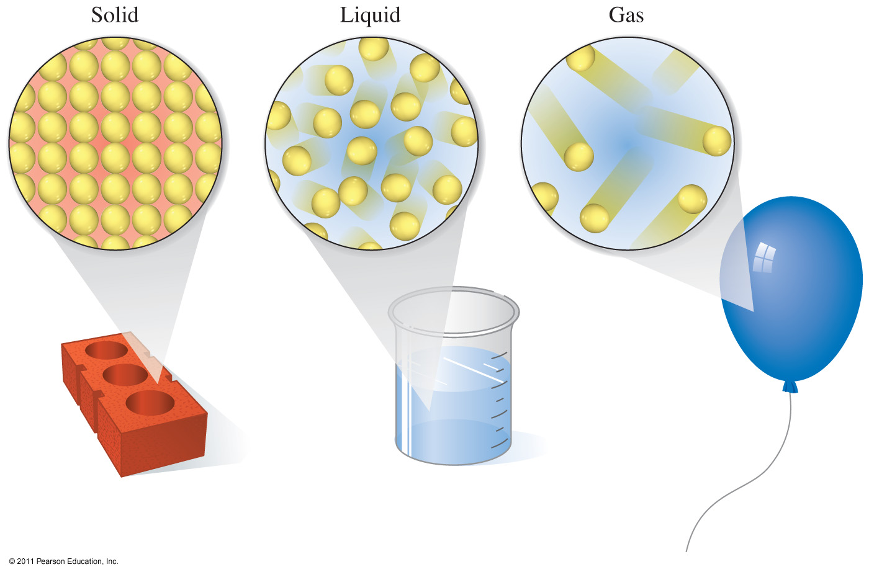
3.1 “Stuff” Is Matter, Continued

Slide 6
3.1 Solids, Liquids and Gases
States of Matter
Common states of matter are solid, liquid, or gas.
A solid has a definite shape and volume. Particles in a solid are tightly packed.
A liquid has a definite volume, but its shape changes depending on the container it is in. Particles in a liquid are less orderly and move about freely.
A gas has no definite volume or shape. Particles in a gas are disordered and rapidly moving.

Slide 7
PROPERTIES OF THE PHASES OF MATTER
 | SOLIDS | LIQUIDS | GASES
SHAPE | Definite – independent of container | Indefinite dependent on container | Indefinite dependent on container
VOLUME | Definite-independent on container | Definite-dependent on container | Indefinite dependent on container

Slide 9
PROPERTIES OF THE PHASES OF MATTER
 | SOLIDS | LIQUIDS | GASES
Temperature | LOW T | HIGHER T | HIGHEST T

Slide 10
Physical Change
sublimation
deposition
freezing
evaporation
SOLID LIQUID GAS
melting or fusion
condensation

Slide 11
Classification of Matter
3.2 The Chemical Elements
Matter
Mixture
Variable Composition
Mixtures = different samples may have the same pieces in different percentages. Two or more pure substances.
salt water

Slide 12
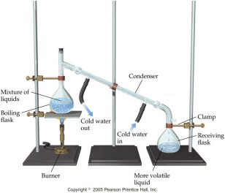
Distillation

Slide 13
Classification of Matter
Matter
Mixture
Variable Composition
Pure Substance
Constant Composition
Pure Substance = all samples are made of the same atoms or molecules in the same percentages
Salt ((NaCl) → Sodium and Chlorine
Water (H₂O) → Hydrogen and Oxygen

Slide 14
Elements
each element has a unique name and symbol
Hydrogen – H
Oxygen – O
Sodium – Na
Chlorine – Cl
There are 116 known elements
Know the names and symbols of the first 36 elements + Ba, Au, Ag, I, Pb, Sn, Hg, Cd, Pt, Sr, U, Xe

Slide 15
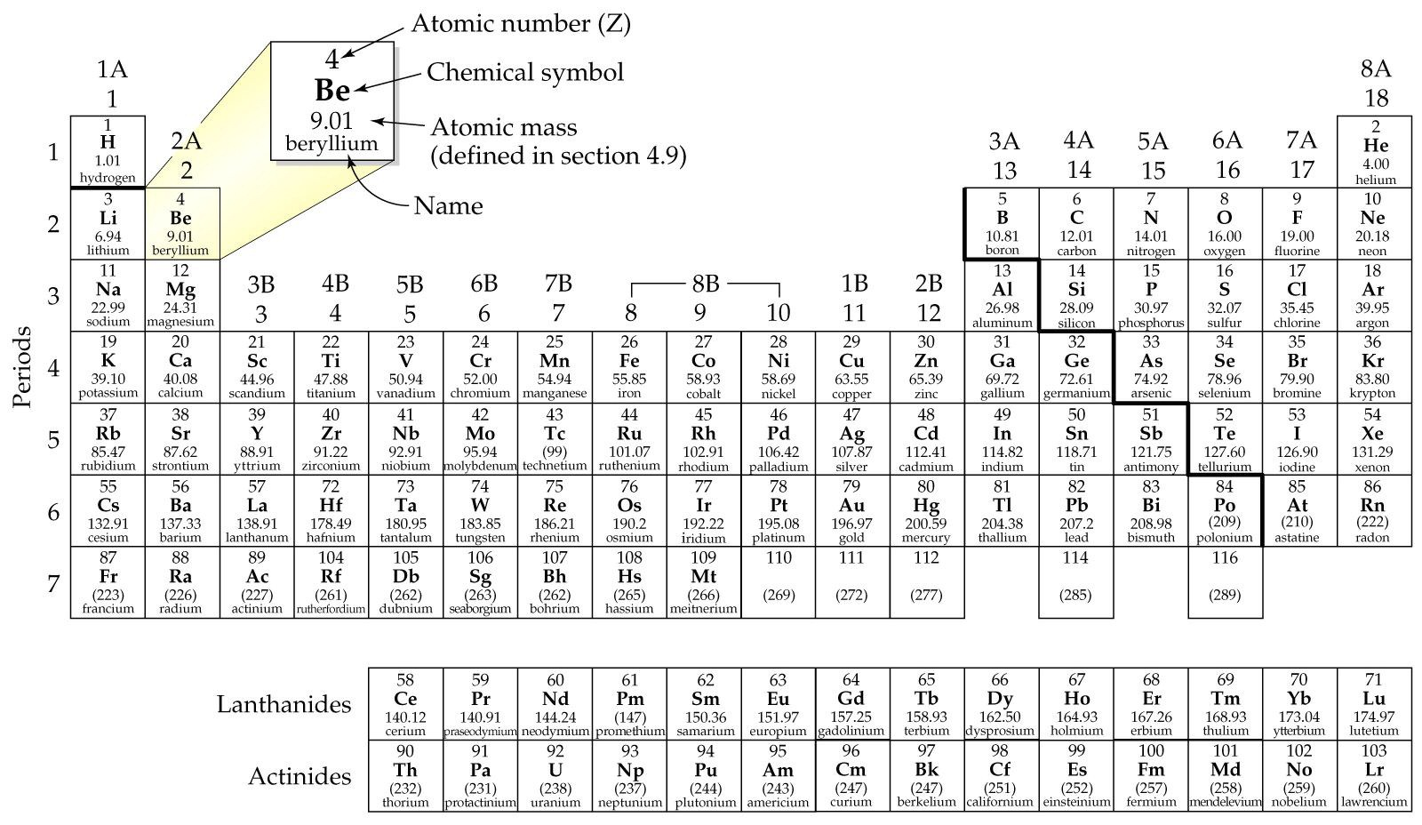
3.3 The Periodic Table of Elements

Slide 16
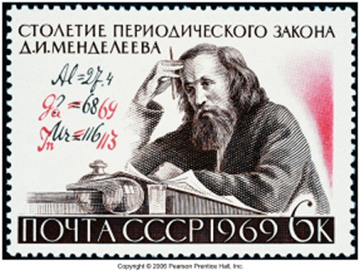
3.3 Mendeleev and the Periodic Law
order elements by atomic mass
saw a repeating pattern of properties
Periodic Law – When the elements are arranged in order of increasing relative mass, certain sets of properties recur periodically
used pattern to predict properties of undiscovered elements

Slide 17
Periodic Pattern
nm H₂O
a/b
H
1 H₂
m Li₂O
b
7 LiH
m/nm BeO
a/b
9 BeH₂
nm B₂O₃
a
11 ( BH₃)_{n}
nm CO₂
a
12 CH₄
nm N₂O₅
a
14 NH₃
nm O₂
16 H₂O
nm OF₂
19 HF
Li
Be
B
C
N
O
F

Slide 18
Periodic Pattern
nm H₂O
a/b
H
1 H₂
m Li₂O
b
7 LiH
m/nm BeO
a/b
9 BeH₂
nm B₂O₃
a
11 ( BH₃)_{n}
nm CO₂
a
12 CH₄
nm N₂O₅
a
14 NH₃
nm O₂
16 H₂O
nm OF₂
19 HF
Li
Be
B
C
N
O
F
m Na₂O
b
23 NaH
m MgO
b
24 MgH₂
m Al₂O₃
a/b
27 (AlH₃)
nm/m SiO₂
a
28 SiH₄
nm P₄O₁₀
a
31 PH₃
nm SO₃
a
32 H₂S
nm Cl₂O₇
a
35.5 HCl
Na
Mg
Al
Si
P
S
Cl

Slide 19
Mendeleev's Predictions for Ekasilicon (Germanium)

Slide 20
Periodicity
= Metal
= Metalloid
= Nonmetal
PerTable Movie

Slide 21
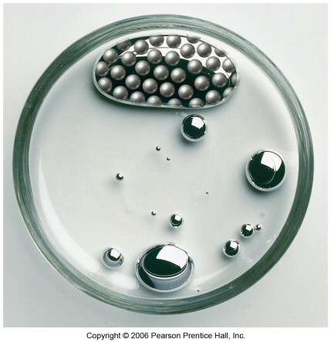
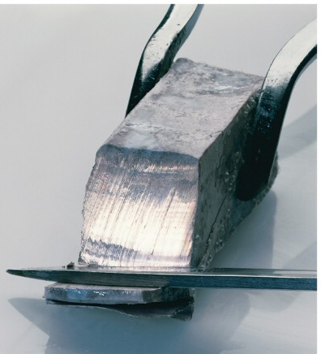
Metals
solids at room temperature, except Hg
shiny
conduct heat
conduct electricity
malleable
ductile
about 75% of the elements are metals
lower left on the table

Slide 22
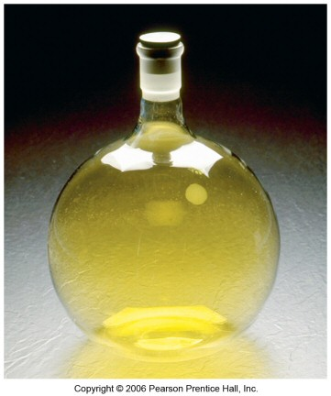
Nonmetals
found in all 3 states
poor conductors of heat
poor conductors of electricity
solids are brittle
upper right on the table

Slide 23
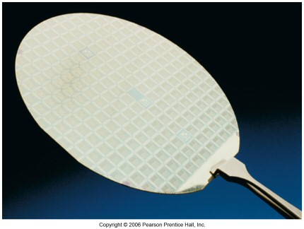
Metalloids
show properties of metals and some of nonmetals
also known as semiconductors
Properties of Silicon
shiny
conducts electricity
does not conduct heat well
brittle

Slide 24
The Modern Periodic Table
Elements with similar chemical and physical properties are in the same column (Groups or Families)
Rows are called Periods

Slide 25
The Modern Periodic Table
Main Group = Representative Elements = ‘A’ groups
Transition Elements = ‘B’ groups
Bottom rows = Inner Transition Elements = Rare Earth Elements

Slide 26
= Alkali Metals
= Halogens
= Alkali Earth Metals
= Lanthanides
= Noble Gases
= Actinides
= Transition Metals
Notes:
add pictures of elements from text

Slide 27
Important Groups - Hydrogen
nonmetal
colorless, diatomic gas
reacts with nonmetals to form molecular compounds
reacts with metals to form hydrides
Many compounds form acids in water

Slide 28
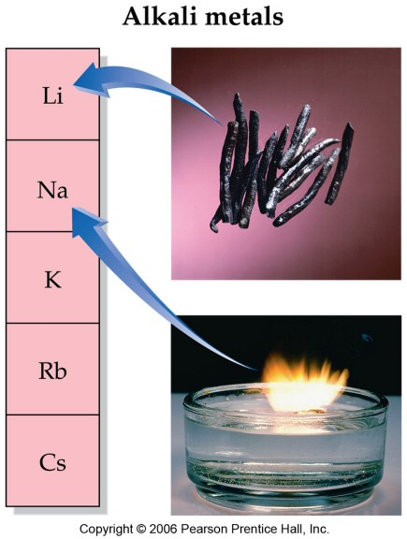
Important Groups – IA, Alkali Metals
hydrogen doesn’t belong
soft, low melting points,low density
very reactive, never find uncombined in nature
tend to form water soluble compounds
react with water to form basic (alkaline) solutions and H₂
lithium
sodium
potassium
rubidium
Alkali metals and water
cesium

Slide 29
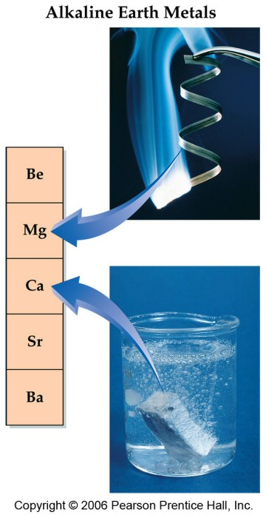
Important Groups – IIA, Alkali Earth Metals
harder, higher melting, and denser than alkali metals
reactive, but less than corresponding alkali metal
form stable, insoluble oxides
oxides are basic
react with water to form H₂
beryllium
magnesium
calcium
strontium
barium

Slide 30
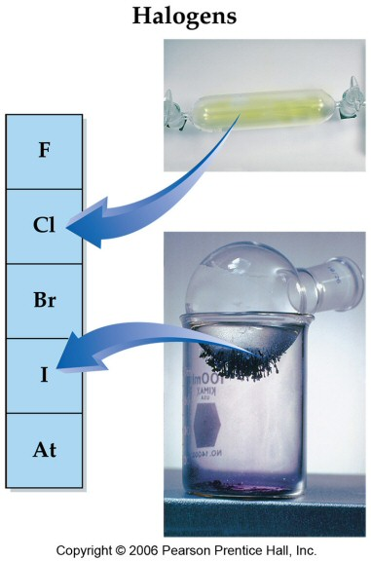
Important Groups – VIIA, Halogens
nonmetals
very reactive
Cl_{2,} Br₂ react slowly with water
react with metals to form ionic compounds
Forms acid when combined with hydrogen
HF weak < HCl < HBr < HI
fluorine
chlorine
bromine
iodine

Slide 31
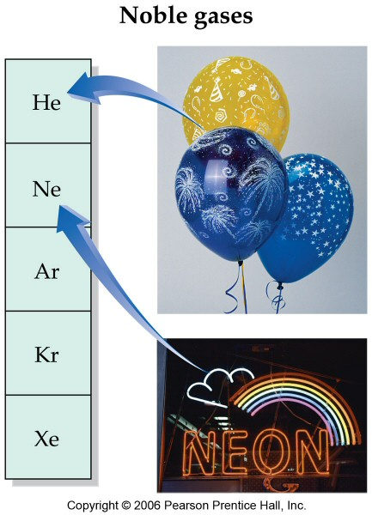
Important Groups – VIIIA, Noble Gases
all gases at room temperature,
very unreactive, practically inert

Slide 32
Atoms
3.4 The Structure of the Elements
Smallest piece of an element is called an atom

Slide 33
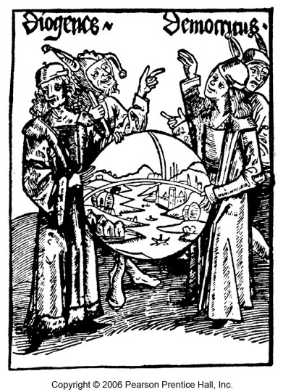
Infinitely Divisible
for any two points there is always a point between
Ultimate Particle
upon division eventually a particle is reached which can no longer be divided
“Nothing exists except atoms and empty space; everything
else is opinion.” - Democritus 460–370 B.C.

Slide 34
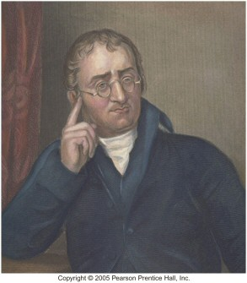
Dalton’s Atomic Theory
Elements are composed of atoms
tiny, hard, unbreakable, spheres
All atoms of an element are identical
Atoms combine in simple, whole-number ratios to form molecules of compounds
Law of Constant Composition
Chemical Formulas
John Dalton
(1766-1844)

Slide 35
Dalton’s Atomic Theory
In chemical reactions, atoms are not broken or changed into another type.
atoms are not created or destroyed, just rearranged
Law of Conservation of Mass

Slide 36
Sizes of Atoms
using compositions of compounds and assumed formulas, Dalton was able to determine the relative masses of the atoms
Dalton based his scale on H = 1 amu
unit = atomic mass unit
absolute sizes of atoms
mass of H atom= 1.67 x 10⁻²⁴g
Diameter ~ 1 x 10⁻¹⁰ m
volume of H atom = 2.1 x 10⁻²⁵cm³

Slide 37
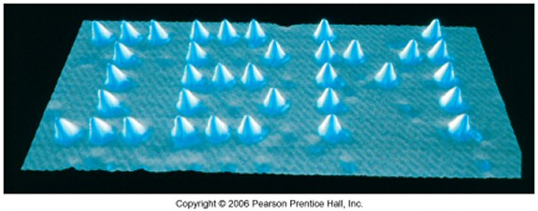
Modern Evidence for Atoms
nanotechnology

Slide 38
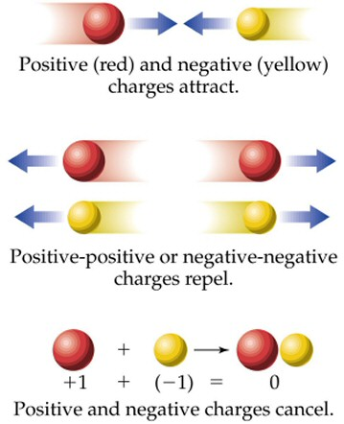
Some Notes on Charge
Two Kinds of Charge called + and –
Opposite Charges Attract
Like Charges Repel
To be Neutral, something must have no charge or equal amounts of opposite charges

Slide 39
Work done by J.J. Thomson and others proved that the atom had pieces called electrons
Thomson found that electrons are much smaller than atoms and carry a negative charge
the mass of the electron is 1/1836th the mass of a hydrogen atom
the charge on the electron is the fundamental unit of charge which we will call –1 charge units
cathode ray tube

Slide 41
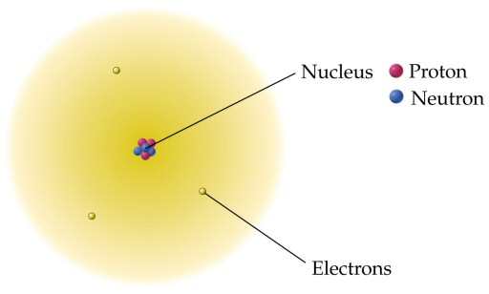
The Modern Atom
Protons, neutrons and electrons
The nucleus – protons and neutrons
The electrons move outside the nucleus

Slide 42
The nuclear atom
The atom contains a tiny dense center called the nucleus
Nucleus = baseball; atom = 2.5 mi, electron = period
The nucleus has essentially the entire mass of the atom
The nucleus is positively charged
The electrons move around in the empty space of the atom surrounding the nucleus
For the atom to be neutral there must be equal numbers of protons and electrons
The nucleus also contains neutrons…mass and proton repulsion.

Slide 43
Ions
Atoms acquire a charge by gaining or losing electrons
Ion Charge = # protons – # electrons
ions with a + charge are called cations
ions with a – charge are called anions

Slide 44
Atomic Structures of Ions
Metals form cations
Cations are named the same as the metal
sodium Na → Na⁺ + 1e⁻ sodium ion
calcium Ca → Ca²⁺ + 2e⁻ calcium ion

Slide 45
Atomic Structures of Ions
Nonmetals form anions
Anions are named by changing the ending of the name to -ide
fluorine F + 1e⁻ → F⁻ fluoride ion
oxygen O + 2e⁻ → O²⁻ oxide ion

Slide 46
Determining the Number of Protons and Electrons in an Ion
Find the number of protons and electrons in the Ca²⁺ ion

Slide 47
Atomic Structures of Ions

Slide 48
Ion Charge & the Periodic Table
metals are always positive ions
for many main group metals, the charge = the group number
nonmetals are negative ions
for nonmetals, the charge = the group number - 8

Slide 49
IA
VIA
IIA
IIIA
VA
VIIA
Li⁺¹
Be⁺²
N⁻³
O⁻²
F⁻¹
Na⁺¹
Mg⁺²
Al⁺³
P⁻³
S⁻²
Cl⁻¹
K⁺¹
Ca⁺²
Ga⁺³
As⁻³
Se⁻²
Br⁻¹
Rb⁺¹
Sr⁺²
In⁺³
Te⁻²
I⁻¹
Cs⁺¹
Ba⁺²

Slide 50
Isotopes
The same element can have atoms with different masses, called isotopes
The observed mass is a weighted average of the weights of all the naturally occurring isotopes

Slide 51
all isotopes of an element are chemically identical
all isotopes of an element have the same number of protons
isotopes of an element have different numbers of neutrons
isotopes are identified by their mass numbers

Slide 52
Neon
Symbol
Number of Protons
Number of Neutrons
A, Mass Number
Percent Natural Abundance
Ne-20 or
10
10
20
90.48%
Ne-21 or
10
11
21
0.27%
Ne-22 or
10
12
22
9.25%

Slide 53
Determining the Number of Protons and Neutrons from Isotope Symbols
How many protons and neutrons in the chromium-52

Slide 54
Practice - Complete the following table

Slide 55
3.5 Common Elements Noble Gases (Group VII) and metals are monatomic H, N, O, F, Cl, Br, I are diatomic

Slide 56
3.6 Relating Mass to Number of Particles
AVERAGE ATOMIC MASS –weighted average mass of all the isotopes
MOLAR MASS – mass in grams of 1 mole of an element

