Slide 1
LIPID TRANSPORT
Lipoproteins
Lipids are transported in the blood as lipoproteins
are soluble in water because the surface consists of polar lipids.

Slide 2
Combine lipids with proteins and phospholipids.
Lipids:
Cholesterol
Cholesteryl esters
Triacylglycerols
Phospholids
Apolipoproteins +
lipoproteins
Lipid transport

Slide 4
There are 4 types of lipoprotein
The lipoprotein formed depends on the constituent protein and lipids
protein
triglyceride
Chylo VLDL LDL HDL

Slide 5
Composition of lipoproteins

Slide 7
INTESTINE
INTESTINAL
EPITHELIAL
CELL
LYMPH/
BLOOD
TG
TG
TG
TG
TG
TG
TG
Bile salts
(emuslification)
TG
Cholesterol
apolipoproteins
Lipases
Fatty acids
glycerol
chylomicrons
TG
Lipid transport

Slide 8
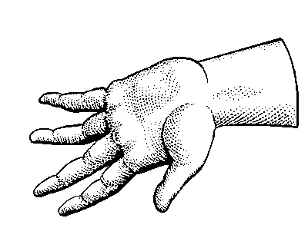
CMCONS
TG
Cholesterol
LIVER
VLDL
TG
Cholesterol
Cholesterol-esters
lymph
HDL
Cholesterol-esters
Fatty acids
albumin
TG
TG
GONADS
ADRENALS
ADIPOSE
MUSCLE
LDL
TISSUES
Cholesterol
Cholesterol-esters
Lipid transport

Slide 9
Fat cell

